Slide 1

EXERCISE RED THUNDER - A
Strike+SEAD+Escort
Range 23
Notes:
2020-03-09: Version 1.0

Slide 2
EXERCISE RED THUNDER - B
Strike+SEAD
Range 23
Notes:
2020-03-09: Version 1.0

Slide 3
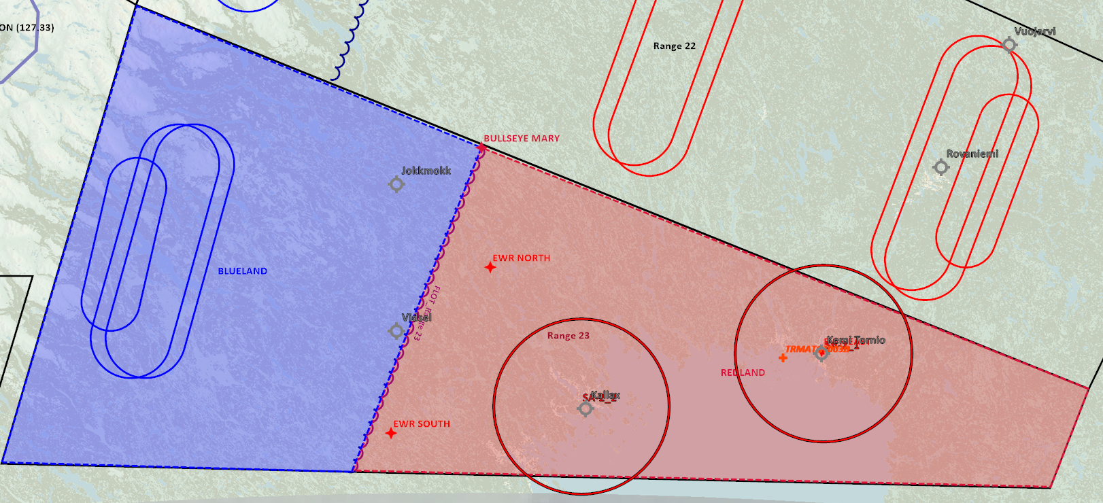
SITUATION
Scenario: REDLAND and BLUELAND at war. BLUELAND have picked up intelligence regarding a chemical weapon research facility in REDLAND.

Slide 4
MISSION
TRMATGT003
Strike REDLAND military research facility (TRMATGT003)
Task strike flight: Conduct strike.
Task SEAD flight: Create permissive environment for strike.
Task Escort flight: Create permissive environment for strike.

Slide 5
MISSION
TRMATGT003
Strike REDLAND military research facility (TRMATGT003)
Task strike flight: Conduct strike.
Task SEAD flight: Create permissive environment for strike.

Slide 6
RED THUNDER A
Blue Commanders intent
BLUE MISSION:
Task: Strike REDLAND military research facility
Purpose: Prevent any information from research facility to be used in the chemical weapon program
BLUE LOSSES NOT ALLOWED
RISK LEVEL: MEDIUM
TRAINING OBJECTIVES:
Objective 1: Strike+SEAD+Escort coordination
Objective 2: Communication between flights (Strike + SEAD)
Objective 3: Mission planning and flight briefing
Objective 4: Strike planning
Objective 5: SEAD planning
Objective 6: Escort planning
Objective 6: Flightlead and wingman practice

Slide 7
RED THUNDER B (no air threats)
Blue Commanders intent
BLUE MISSION:
Task: Strike REDLAND military research facility
Purpose: Prevent any information from research facility to be used in the chemical weapon program
BLUE LOSSES NOT ALLOWED
RISK LEVEL: LOW
TRAINING OBJECTIVES:
-Objective 1: Strike+SEAD coordination - Objective 2: Communication between flights (Strike + SEAD) - Objective 3: Mission planning and flight briefing - Objective 4: Strike planning - Objective 5: SEAD planning - Objective 6: Flightlead and wingman practice

Slide 8
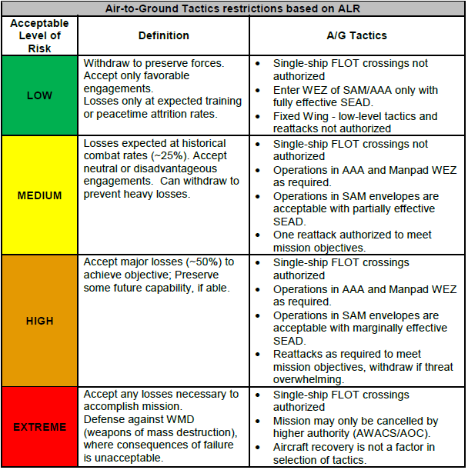
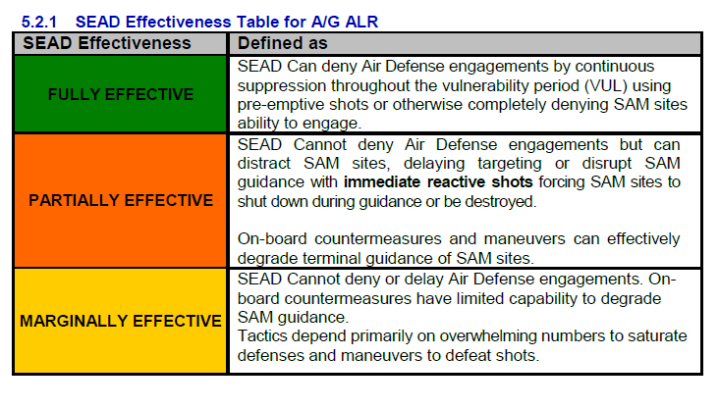
RED THUNDER A
Blue ALR

Slide 9
RED THUNDER B (no air threats)
Blue ALR

Slide 10
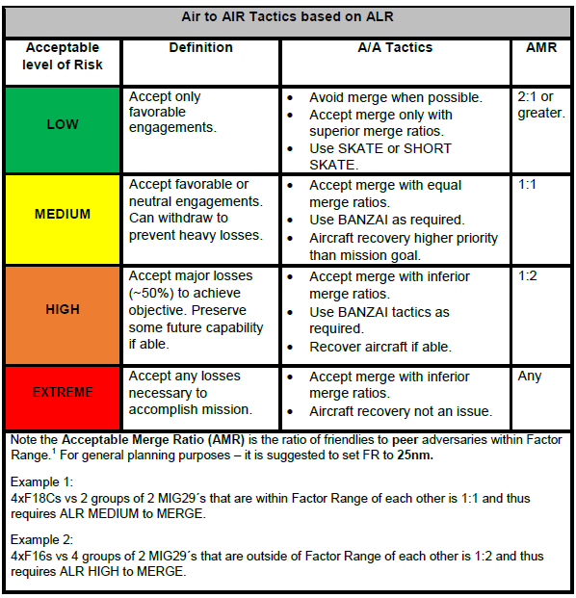
RED THUNDER A
Blue ALR

Slide 11
RED THUNDER B (no air threats)
Blue ALR

Slide 12
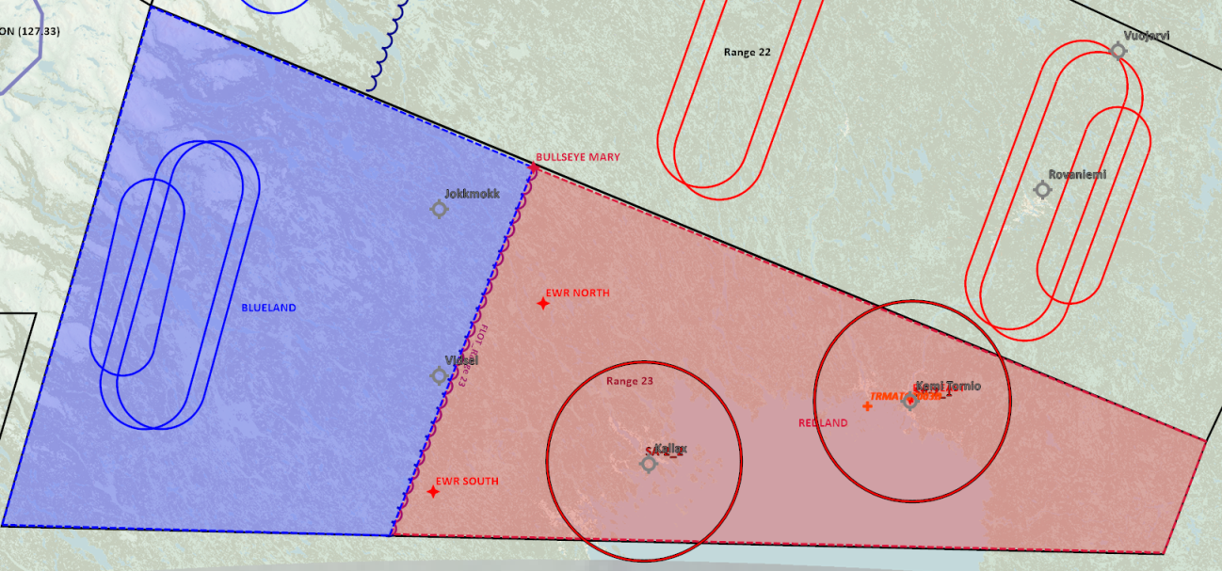
RED THUNDER A (full package)
THREATS
SAM THREATs: SA-2s are protecting REDLAND airfields KALLAX and KEMI TORNIO. In addition SA-11 and SA-6 are mobile threats likely operating in REDLAND territory.
REDLAND Airforce consist of 3 squadrons:
Squadron 1: F-16
Squadron 2: F/A-18
Squadron 3: F-14
These squadrons are normally rotating through KALLAX and KEMI TORNIO.
These 3 squadrons normally rotate on DCA (Defensive Counter Air) duties. Normal modus of operandi is to have one flight airborne as a CAP, or on ground alert as a QRA with a 5 minute alert. Normally one additional flight is on backup as QRA 15 minute alert.
- REDLAND jets have routinely violated BLUELAND airspace and established CAP on BLUELAND side of border

Slide 13
RED THUNDER B (no air threats)
THREATS
SAM THREATs: SA-2s are protecting REDLAND airfields KALLAX and KEMI TORNIO. In addition SA-11 and SA-6 are mobile threats likely operating in REDLAND territory.
REDLAND airforce have been neutralized for the next 24 hours due to a coordinated strike at all runways in REDLAND territory

Slide 14
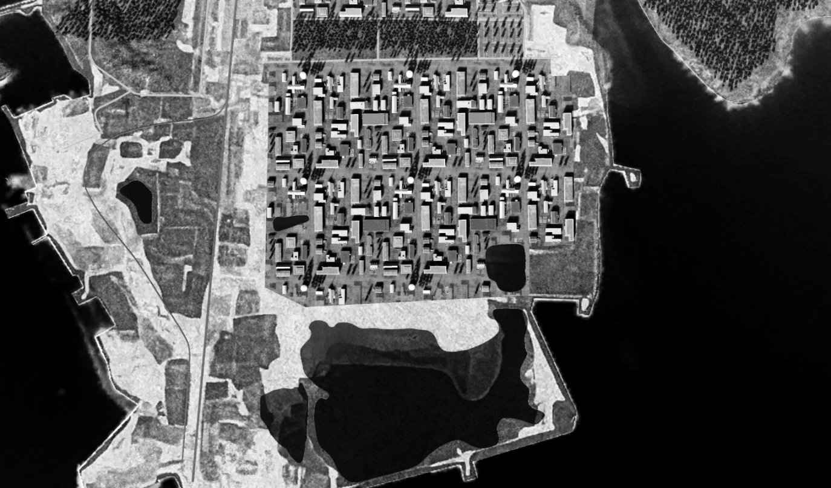
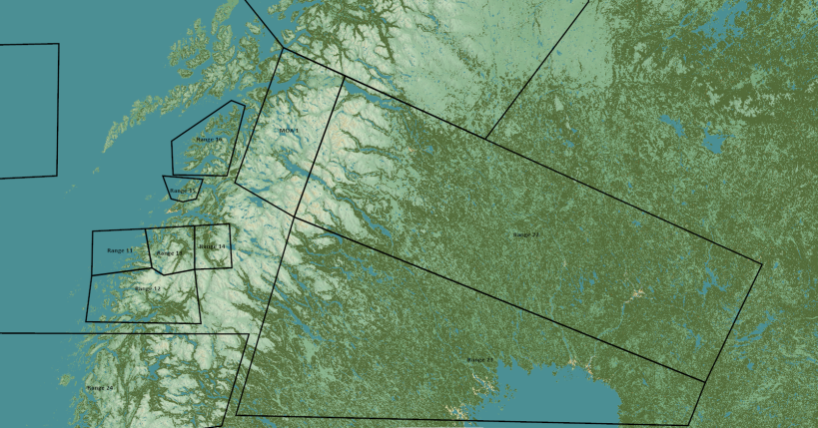
TRMATGT003 Military Research Facility
N
TRMATG003C
003
TRMATG003D
DESCRIPTION OF THE DESIRED POINTS OF IMPACT WITH WPN TYPE:
(TLE CAT 1 Coordinates)
TRMATGT003A – Military Research Facility
DPI 1: N65 45.779 E024 10.347/ Elevation: 29ft
TRMATGT003B – Military Research Facility
DPI 1: N65 45.778 E024 10.899/ Elevation: 17ft
TRMATGT003C – Military Research Facility
DPI 1: N65 45.864 E024 10.484/ Elevation: 28ft
TRMATGT003D – Military Research Facility
DPI 1: N65 45.862 E024 11.035/ Elevation: 27ft
Weaponeering:
1x GBU 31(V)3/B Penetrator bomb.
Function delay: 60ms
In order to completely destroy the servers stored in hardened facilities underground, the penetrator bomb is needed with a delay of 60ms.
TRMATG003A
TRMATG003B
TRMATGT003 Military Research Facility is a covert researcg facility for REDLAND Chemical Weapon program.
Target 3A, 3B,3C and 3D must be attacked at the same time due to risk enemy beeing able to flee the targets and recover harddrives with information from the CW program.

Slide 15
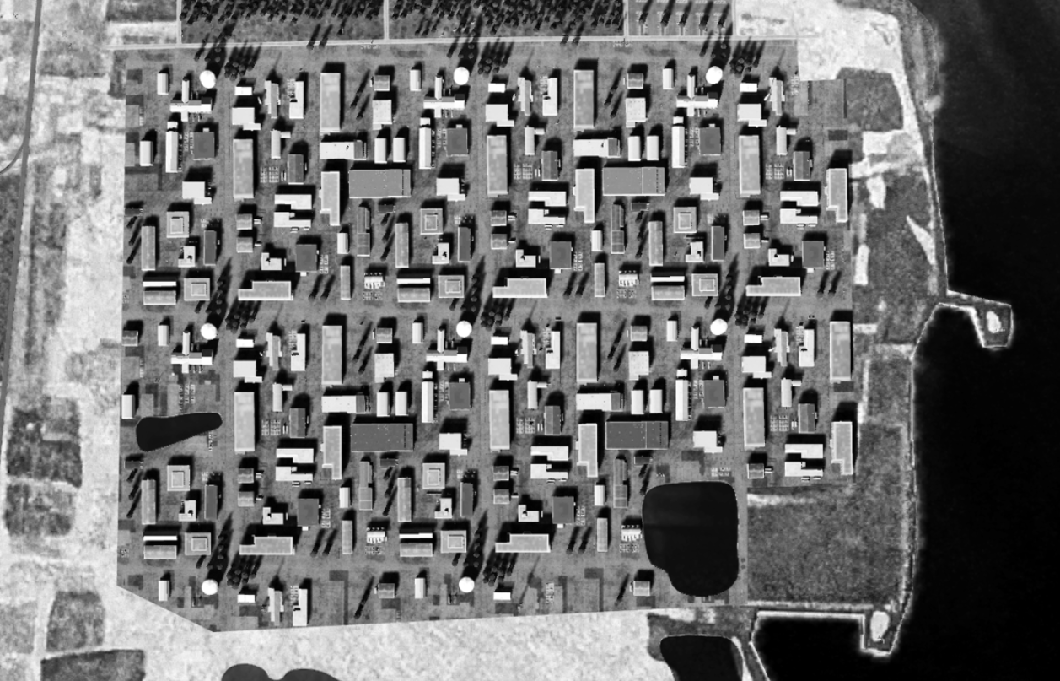
TRMATGT003 Military Research Facility
N
3C
3D
3A
3B

Slide 16
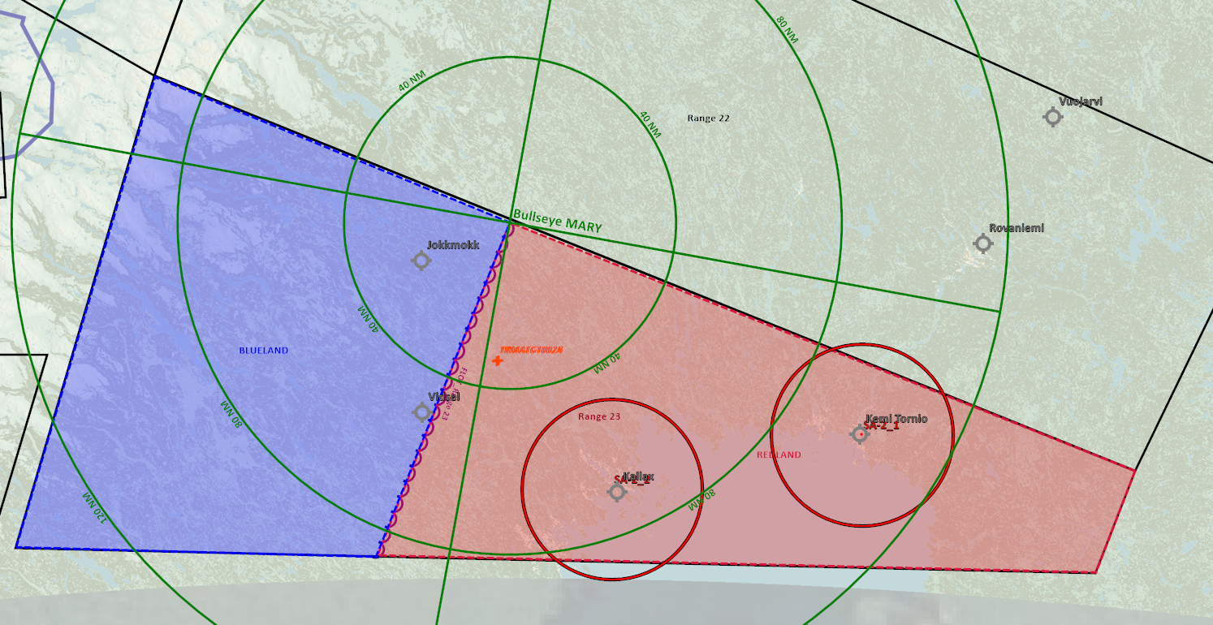
BULLSEYE
Same for both BLUE and RED

Slide 17
AAR Support
BLUE: AR202 (F-16) AR302 (F-14, F/A-18)
Tankers need to be activated via F10 menu manually

Slide 18
RED THUNDER A (full package)
AAR Support
BLUE: AR202 (F-16) AR302 (F-14, F/A-18)
RED: Tankers available on request in range 22, but not needed for scenario
Tankers need to be activated via F10 menu manually (Blue will activate BLUE tanker, Red will activate RED tanker)

Slide 19
RED THUNDER A (full package)
Flow and admin
This mission is conducted in the following way:
Blue force plan according this this brief.
Red force (aggressor conduct own plan in according to Red Commanders intent, to facilitate and meet Blue force training objectives).
Flight announces killed by announcing on Safety&Kill freq (or AWACS freq if AWACS is supporting) & by squawking IFF 4000
Once killed, RED (aggressor) aircraft will spiral and dive down toward the ground and flow to reset area.
BLUE will continue regardless of beeing it. Red aggressors will land/touch-and-go at Reset airfield, and can get airborne again immediately to get back in the fight. (If AWACS is supporting BLUE, then AWACS can respawn red aggressors outside reset points at AWACS discretion).
Flights observes kills by missile script information
RESET BLUE: N/A – Continue mission and debrief hits after event
RESET RED: Kallax airbase
HARD DECK: N/A
IF AWACS is supporting RED side: (BLUE AWACS on by default)
RED AWACS need to be activated using F10 menu (WIZARD)

Slide 20
RED THUNDER A (full package)
Command & Control
IF AWACS:
If 1 AWACS controller, AWACS will support Blue package
Safety & Kill frequency: 242.0 (Range 23 primary freq) (monitored by AWACS + aggressors)
Tactical freq: (Blue package+AWACS) 226.5 (Tactical frequency 1)
AWACS controls RED/BLUE on tactical freq and coordinate with the other side for event start and kills on Safety & Kill freq.
IF NOT AWACS:
- Package frequency (BLUE): 242.0 (Range 23 primary freq)
Safety & Kill frequency: Range 23 primary (242.0) (Aggressors monitor package and announce kills/safety/coordination only)
All kills announced on S&K freq

Slide 21
RED THUNDER A (full package)
Red Commanders intent
MISSION: DEFEND RED TERRITORY FROM BLUE INTRUSION
RED LOSSES ALLOWED
RISK LEVEL: HIGH
TRAINING OBJECTIVES:
- Objective 1: DCA CAP mission - Objective 2: Practice Grinder tactics (Counter Rotating CAP) - Objective 3: Good SA on potential threats - Objective 4: Timeline for engagement - Objective 5: Communications within the flight - Objective 6: Missile defense - Objective 7: Mission planning and flight briefing - Objective 8: Flight lead and wingman training

Slide 22
RED THUNDER A (full package)
Red ALR

